Slide 1
Blooms – Active verbs

Slide 2
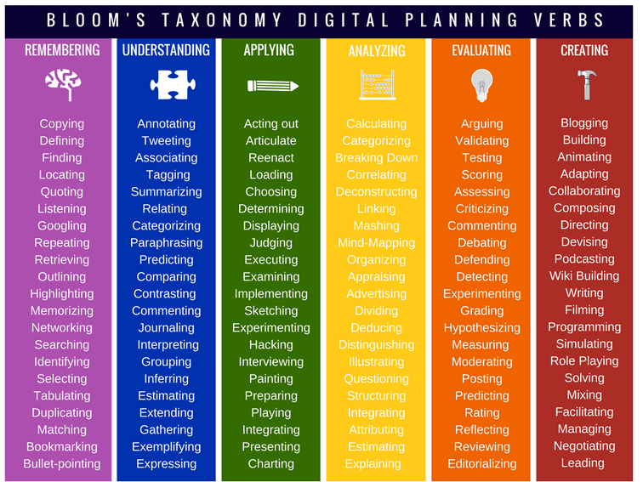

Slide 3
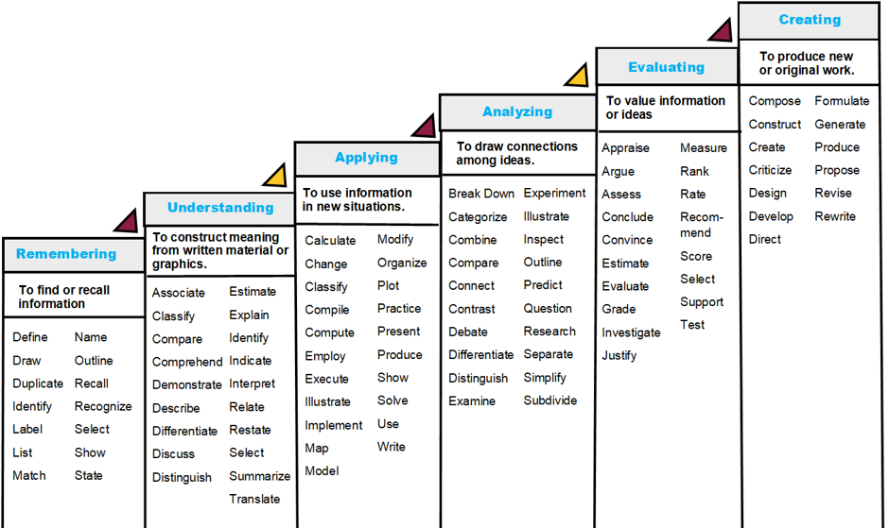

Slide 4
